Slide 1
أكـــــاديميــــة طــــويـــق
Deep Learning

Slide 2
Generative Adversarial Networks (GANs)
By: Dr. Afshan Hashmi

Slide 3
Topics Covered:
Understanding Generative Adversarial Networks (GANs) .
Generator Model
Discriminator Model
Working of Generative Adversarial Networks (GANs)
Types of Generative Adversarial Networks (GANs)
Advantages and Limitation of GAN
Image Generation with GAN(Implementation)

Slide 4
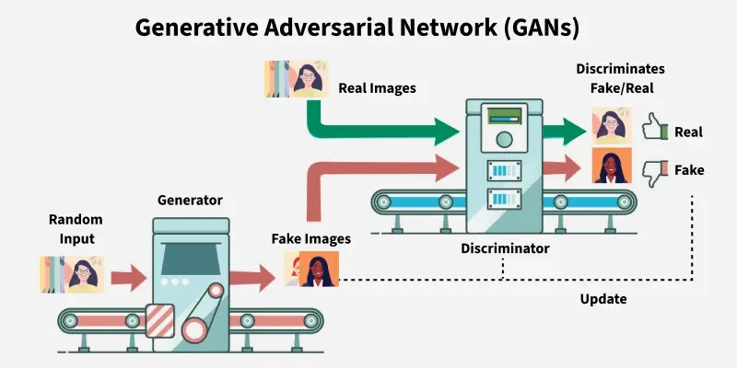
Understanding GPT (Generative Pre-trained Transformer)
Generative Adversarial Networks (GANs), introduced by Ian Goodfellow and colleagues in 2014, are a class of neural networks designed to autonomously learn patterns from input data and generate new examples that resemble the original dataset.
The architecture of a GAN comprises two competing neural networks:
Generator: This network's role is to create synthetic data from random noise. Its objective is to produce data that is so realistic that the discriminator cannot differentiate it from real data.
Discriminator: Acting as a critic, this network evaluates the data it receives (which can be either real data from the dataset or synthetic data from the generator) and determines whether it is real or fake.

Slide 5
1. Generator Model
The Generator is a deep neural network responsible for creating synthetic data samples.
Input: It takes random noise (often a latent vector z) as its input.
Output: It produces realistic data samples (e.g., images, text, audio) that aim to mimic the real data distribution.
Learning Process: The Generator learns the underlying data distribution by adjusting its parameters through backpropagation.
Objective: The Generator's primary goal is to produce samples that the Discriminator classifies as real. It wants to "fool" the Discriminator.
Loss Function:
The Generator aims to minimize the following loss function:
J_G = - (1/m) * Sum(log D(G(z_i)))
Where:
J_G: Measures how well the Generator is fooling the Discriminator.
D(G(z_i)): Represents the Discriminator's output (probability) that a generated sample G(z_i) is real.
log D(G(z_i)): The logarithm of this probability.
m: The number of samples in the batch.
The Generator aims to make D(G(z_i)) as close to 1 as possible, meaning the Discriminator believes the generated samples are real. Minimizing -log D(G(z_i)) achieves this.

Slide 6
2. Discriminator Model
The Discriminator acts as a binary classifier, tasked with distinguishing between real and generated data.
Role: It learns to improve its classification ability through training, refining its parameters to detect fake samples more accurately.
Architecture: When dealing with image data, the Discriminator often employs convolutional layers or other relevant architectures suited to the data type. These layers help extract features crucial for differentiation.
Objective: The Discriminator aims to maximize its ability to correctly classify real samples as real and generated samples as fake.
Loss Function:
The Discriminator minimizes the negative log likelihood of correctly classifying both produced and real samples. This loss incentivizes the Discriminator to accurately categorize generated samples as fake and real samples as real.
J_D = - (1/m) * Sum(log D(x_i)) - (1/m) * Sum(log(1 - D(G(z_i))))
Where:
J_D: Assesses the Discriminator's ability to discern between produced and actual samples.
log D(x_i): Represents the log probability that the Discriminator will accurately categorize real data (x_i) as real.
log(1 - D(G(z_i))): Represents the log probability that the Discriminator would correctly categorize generated samples (G(z_i)) as fake.

Slide 7
2. Discriminator Model
By minimizing this loss, the Discriminator becomes more effective at distinguishing between real and generated samples.
Minimax Loss
GANs operate on a minimax optimization framework, where the Generator and Discriminator are adversaries in a zero-sum game:
min_G max_D V(G, D) = E_x~p_data(x)[log D(x)] + E_z~p_z(z)[log(1 - D(g(z)))]
Where:
G: Represents the Generator network.
D: Represents the Discriminator network.
x: Actual data samples obtained from the true data distribution p_data(x).
z: Random noise sampled from a prior distribution p_z(z) (usually a normal or uniform distribution).
D(x): Represents the Discriminator's likelihood of correctly identifying actual data x as real.
D(G(z)): Is the likelihood that the Discriminator will identify generated data G(z) (coming from the Generator) as authentic.
The generator aims to minimize the loss, while the discriminator tries to maximize its classification accuracy.

Slide 8
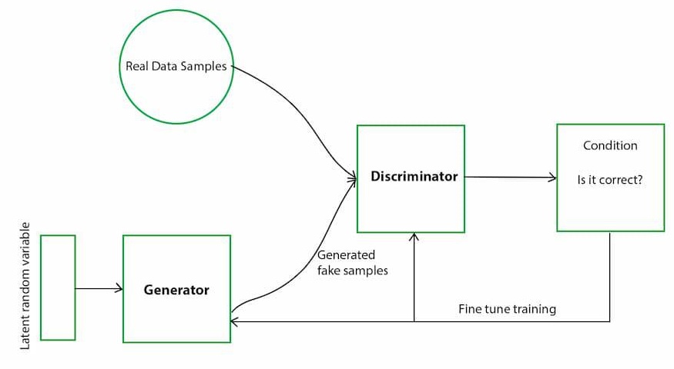
How a GAN Works: The Adversarial Training Loop
GANs learn through a continuous, competitive game between two neural networks: the Generator (G) and the Discriminator (D).
Generator's First Move (Generating Fakes):
The Generator (G) takes a random noise vector (e.g., a random set of numbers) as input.
Using its learned internal layers, G transforms this noise into a synthetic data sample (e.g., a generated image, a piece of text). Initially, these generated samples are often poor quality.

Slide 9
How a GAN Works: The Adversarial Training Loop
Discriminator's Turn (Critiquing Data):
The Discriminator (D) receives two types of data:
Real data samples directly from the training dataset.
The fake data samples generated by G in the previous step.
D's task is to act as a binary classifier: for each input, it outputs a probability score between 0 and 1. A score closer to 1 means D believes the data is real, while a score closer to 0 means D believes it's fake.
Adversarial Learning (Updating Networks):
Discriminator Update: If D correctly classifies real data as real and fake data as fake, its parameters are adjusted slightly to improve its detection capabilities.
Generator Update: If G successfully "fools" D (meaning D classifies G's fake data as real), G receives a positive update to its parameters, encouraging it to generate even more convincing fakes. Conversely, D is penalized for its misclassification.

Slide 10
How a GAN Works: The Adversarial Training Loop
Generator's Improvement:
With each successful "fooling" of the Discriminator, the Generator learns and refines its ability to produce more realistic synthetic samples. It adjusts its weights to better capture the underlying patterns of the real data.
Discriminator's Adaptation:
As the Generator improves, the Discriminator continuously adapts and refines its own parameters. It becomes better at identifying the increasingly sophisticated fake samples generated by G. This ongoing challenge forces D to learn more subtle features that differentiate real from fake.
Training Progression and Convergence:
This continuous "duel" drives both networks to improve. As training progresses, the Generator becomes highly proficient at producing data that is visually (or otherwise) indistinguishable from real data.
Eventually, the Discriminator's accuracy in distinguishing real from fake approaches 50% (random guessing), indicating that the Generator has reached a point where it can consistently produce highly realistic data.
At this well-trained state, the Generator can be used independently to generate high-quality synthetic data for various applications.

Slide 11
Types of GANs
Vanilla GAN:
Simplest form of GAN.
Both Generator and Discriminator are built using Multi-Layer Perceptrons (MLPs).
Optimized using Stochastic Gradient Descent (SGD).
Limitations: Often suffers from issues like mode collapse (Generator produces limited variety of outputs) and unstable training.
Conditional GAN (CGAN):
Introduces an additional conditional parameter (y) to guide the generation process.
Working: The conditional variable y is fed into both the Generator and the Discriminator.
Generator creates data corresponding to the given condition (e.g., generating images of specific objects/classes).
Discriminator also receives the labels (y) to help distinguish between real and fake data for that specific condition.
Benefit: Allows for controlled generation of specific types of outputs, rather than just random samples.

Slide 12
Types of GANs
Deep Convolutional GAN (DCGAN):
One of the most popular and widely used GAN types, especially for image generation.
Key Features:
Utilizes Convolutional Neural Networks (CNNs) for both Generator and Discriminator, replacing MLPs.
Replaces max-pooling layers with convolutional strides for efficiency.
Removes fully connected layers (except for the final output layer in the Discriminator), improving spatial understanding.
Benefit: Highly successful in generating high-quality images.
4. Laplacian Pyramid GAN (LAPGAN):
Designed for generating ultra-high-quality images using a multi-resolution approach.
Working:
Employs multiple Generator-Discriminator pairs operating at different levels of a Laplacian pyramid.
Images are progressively refined: downsampled at each layer and then upscaled using Conditional GANs (CGANs).
Benefit: Gradually refines image details, reducing noise and improving clarity, leading to photorealistic results.

Slide 13
Types of GANs
5. Super-Resolution GAN (SRGAN):
Specifically designed to increase the resolution of low-quality images while preserving details.
Working:
Combines a deep neural network with an adversarial loss function.
Enhances low-resolution images by adding finer details, making them appear sharper and more realistic.
Benefit: Helps reduce common image upscaling artifacts like blurriness and pixelation.

Slide 14
Applications of Generative Adversarial Networks (GANs)
Image Synthesis & Generation:
Generate realistic images, avatars, and high-resolution visuals by learning patterns from training data.
Widely used in digital art, gaming, and AI-driven design.
Image-to-Image Translation:
Transform images between different domains while preserving essential features.
Examples: converting day scenes to night, turning sketches into realistic images, or applying different artistic styles.
Text-to-Image Synthesis:
Create visual content directly from textual descriptions.
Enables applications in AI-generated art, automated design, and innovative content creation.
Data Augmentation:
Generate synthetic data samples to expand training datasets for machine learning models.
Improves model robustness and generalizability, particularly valuable in domains with limited labeled data.
High-Resolution Image Enhancement (Super-Resolution):
Upscale low-resolution images to higher resolutions, significantly improving clarity and detail.
Applications include medical imaging, satellite imagery analysis, and video enhancement.

Slide 15
Evaluation metrics of GAN
Metric | Purpose
Inception Score (IS) | Measures image quality and diversity
Frechet Inception Distance (FID) | Measures similarity to real data distribution
Visual Turing Test | Human-based evaluation of realism

Slide 16
Advantages of Generative Adversarial Networks (GANs)
Synthetic Data Generation: GANs excel at creating new, synthetic data samples that closely resemble a known data distribution. This is highly beneficial for data augmentation, anomaly detection, and various creative applications.
High-Quality Results: They are capable of producing exceptionally high-quality and often photorealistic outputs in diverse domains such as image synthesis, video synthesis, and music synthesis.
Unsupervised Learning: A significant advantage is their ability to be trained without the need for labeled data. This makes GANs particularly valuable for unsupervised learning tasks where obtaining large, labeled datasets is challenging or impractical.
Versatility: GANs demonstrate broad applicability across a wide spectrum of tasks, including but not limited to image synthesis, text-to-image generation, image-to-image translation, anomaly detection, and data augmentation.

Slide 17
Limitations of Generative Adversarial Networks (GANs)
1. Training Instability
GANs are notoriously difficult to train. The generator and discriminator are locked in a two-player minimax game, where the success of one depends on the failure of the other. This adversarial dynamic can lead to:
Non-convergence: The model may never reach a stable state.
Oscillations: The generator and discriminator may oscillate without making real progress.
Vanishing gradients: If the discriminator becomes too strong, the generator receives little to no feedback, slowing or halting learning.
2. Mode Collapse
In mode collapse, the generator starts producing a limited variety of outputs, even when the input noise is different. This happens when:
The generator finds a small set of outputs that consistently fool the discriminator.
It continues to exploit this weakness, reducing diversity in the generated data.
As a result, the GAN fails to capture the full range of patterns or classes in the dataset (e.g., generating only one type of face when trained on a diverse face dataset).

Slide 18
Limitations of Generative Adversarial Networks (GANs)
3. Lack of Interpretability
Unlike supervised models where outputs can be traced to specific features or labels, GANs function as black boxes:
There is no clear way to understand what each neuron or layer in the generator/discriminator is learning.
It is hard to diagnose what causes failures such as mode collapse or poor image quality.
This lack of transparency makes debugging and improving GANs more difficult.
4. High Data and Computational Requirements
Training GANs typically requires:
Large volumes of high-quality data to capture complex distributions and generate realistic outputs.
Significant computational power, often involving GPUs or TPUs, especially for deep GAN architectures like StyleGAN or BigGAN.
This limits their use in low-resource environments or for applications with limited training data.

Slide 19
Strategies and Variants to Overcome GAN Limitations
Researchers have proposed various modifications and architectural improvements to tackle the challenges of training GANs effectively:
1. Wasserstein GAN (WGAN)
To address training instability and mode collapse, the Wasserstein GAN replaces the traditional loss function with the Wasserstein distance (Earth Mover's Distance), providing a smoother and more meaningful gradient signal.
Benefits:
More stable training.
Improved convergence behavior.
Better correlation between loss value and image quality.
Improvement: Later versions like WGAN-GP (Gradient Penalty) added regularization to enforce the Lipschitz constraint without weight clipping.
2. Mini-batch Discrimination
This technique reduces mode collapse by enabling the discriminator to look at a batch of samples together instead of independently.
How it helps:
Encourages the generator to produce a diverse set of outputs within a mini-batch.
Penalizes the generator if it generates samples that are too similar.

Slide 20
Strategies and Variants to Overcome GAN Limitations
3. Unrolled GANs
Unrolled GANs help stabilize training by simulating several updates of the discriminator ahead of time.
Key idea:
During generator updates, unroll the discriminator for a few steps to provide a more responsive gradient signal.
Reduces training instability and mode collapse.
4. Spectral Normalization
Proposed as a regularization technique to improve discriminator stability, spectral normalization constrains the Lipschitz constant of the discriminator.
Result:
Smoother gradients.
Prevents discriminator from overpowering the generator.
Encourages more stable learning dynamics.
5. Progressive Growing of GANs (PGGAN)
Instead of training on full-sized images from the beginning, PGGAN gradually increases the resolution of generated images during training.
Advantages:
Improves training stability.
Generates high-resolution, photorealistic images (used in face generation, e.g., StyleGAN).
Reduces computational burden in early training phases.

Slide 21
Strategies and Variants to Overcome GAN Limitations
6. Conditional GANs (cGANs)
To improve control and interpretability, cGANs condition the generation process on external data (e.g., class labels).
Applications:
Generate specific categories (e.g., digits, cats, or faces).
Enables class-conditional generation and improved diversity.
7. StyleGAN and StyleGAN2
StyleGAN architectures introduce style-based generation, allowing finer control over features like facial expressions, hair color, and pose.
Notable innovations:
Adaptive instance normalization (AdaIN).
Better disentanglement of high-level visual attributes.
Generates state-of-the-art images (used in deepfakes, avatars).

Slide 22
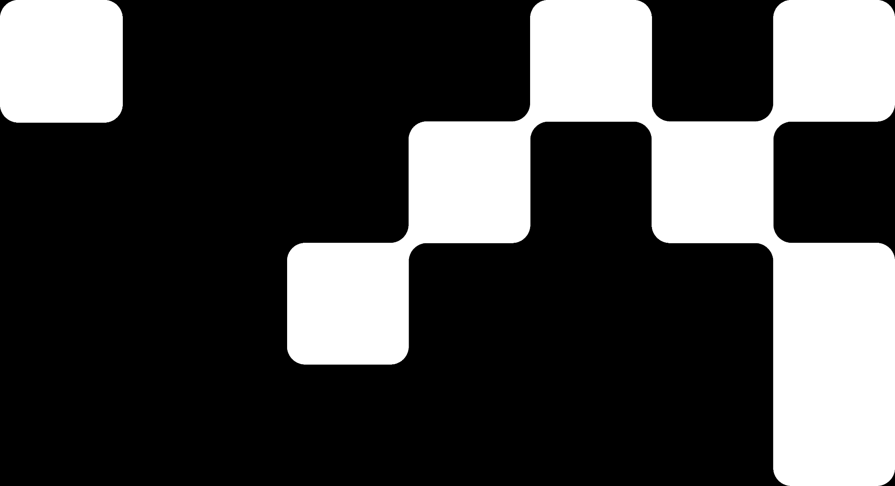
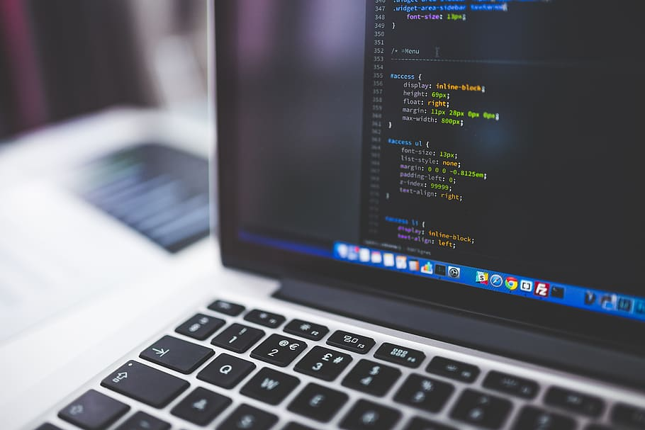
Hands On Exercise
Click Here For The Implementation on Google Colab
https://drive.google.com/file/d/144LdLXIGlouWjXTOBsq6faM2YrEaSdeT/view?usp=share_link

Slide 23
Books and References
"Neural Networks and Deep Learning" (Michael Nielsen)
Deep Learning for Computer Vision (Rajalingappaa Shanmugamani)
https://www.geeksforgeeks.org/generative-adversarial-network-gan/
Goodfellow, I., Bengio, Y., & Courville, A. (2016). Deep Learning. MIT Press.
Chollet, F. (2017). Deep Learning with Python. Manning Publications.
Hochreiter, S., & Schmidhuber, J. (1997). Long Short-Term Memory. Neural Computation.

Slide 24

















الشراكات العالمية

Slide 25
شــــــكــــرًا لكــــــم
THANK YOU

